Slide 1
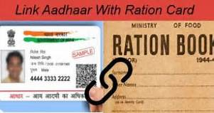






Ministry Category: Government of Gujarat-Software
Problem Statement : Mechanism to avoid duplication of beneficiaries of various welfare schemes.(Awas Yojana) | College Code: 001
Team Leader Name : Aditya Salvli
Software
+
Database
(For Validation of Aadhar card &
BPL card)
Database Entry
My SQL
Network
Web Application

Slide 2
Idea Approach Details
Government officer : To monitor Registration Details.
People : To register the Awas.
Database Administrator : To handle Entire Database.
Network Handler: To manage Network Connection.
Database.
Internet Connection.
Web application.
Network

Slide 3
Registration
YES
Document
verification
NO
Linking Aadhar card
of all family members
with BPL card
Correct document
required
Duplication
occur
“You are not
eligible for this
Awas Yojna”
Redundancy checking
Of BPLcard
eligible
Allocate Awas
Done

